Slide 1
MICROSERVICE ARCHITECTURE
Presented by
Loic Sanou : Software Ingineer logiciel at Capgemini.

Slide 2

Plan de présentation
What is Microservice?
What is Monolithic Architecture and It’s Drawbacks
What is SOA Architecture ?
Why to Use Microservice Architecture?
Challenges in Microservices Implementation and How to Resolve It
Microservice Architecture
Use of API Gateway
What is Service Discovery and Eureka? Fault Tolerance With Hystrix
Centralized Configuration Using Spring Cloud Config Server
Microservice Monitoring

Slide 3

What are Microservices
Essentially, microservices architecture is a software development method that aims to decompose an application to isolate its key functions, each of which is called a "service".
These services are created to meet a precise and unique business need, for example: user management, payments, e-mailing or notifications. What's more, they are independent and modular, so that each can be developed and deployed without affecting the others.
This type of architecture is the opposite of monolithic architectures, which are built as a single, autonomous unit.
Microservices architectures enable the development, deployment and operational management of distributed applications, made up of services with complementary, potentially heterogeneous and interoperable functionalities.

Slide 4
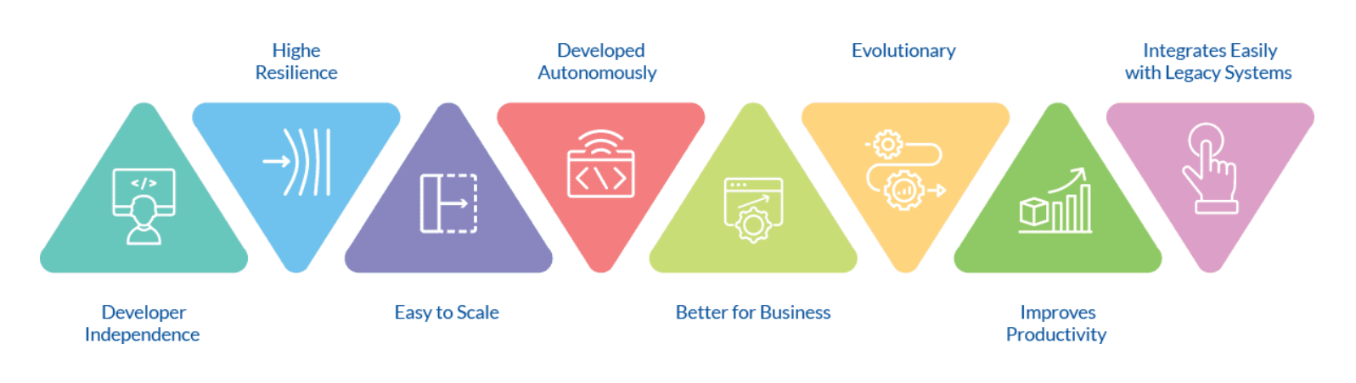
Microservices advantages
https://www.zucisystems.com/be/test-de-logiciel/architecture-de-microservices/#MicroservicesImportant

Slide 5
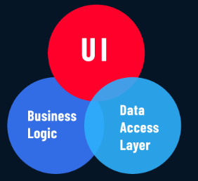
What is Monolithic Architecture
A monolithic architecture is a traditional development program model, designed as a unified unit that stands alone and is independent of other apps.
A microservices architecture is the exact opposite of a monolith, as it is an architectural method based on a series of independently deployable services.
Monoliths may be preferable at the beginning of a project's life, due to the ease of managing code, cognitive load and deployment.
Once a monolithic app becomes large and complex, it is not easy to evolve, continuous deployment is difficult and updates can be tedious.

Slide 6
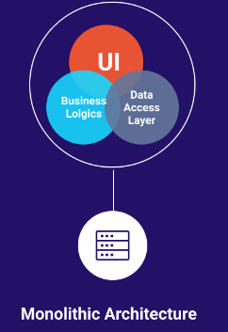
Monolithic Architecture Drawbacks
Large monolithic code base is very difficult to understand
It’s not fault tolerant
Overloaded Web Container and Overloaded IDE
Frequent deployment is difficult
Scaling the application is difficult
“A monolithic architecture forces you to be married to the technology stack (and in some cases, to a particular version of the technology) you choose at the start of the development.”

Slide 7
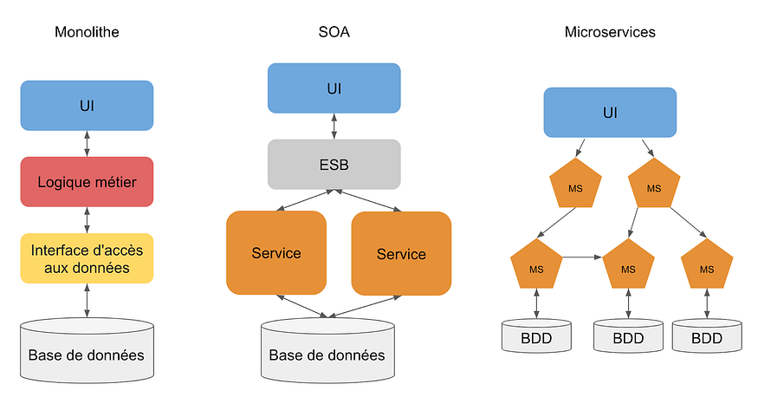
What is SOA Architecture ?
La principale différence entre SOA et microservices réside dans la portée de leur architecture. Dans le modèle SOA, les services ou modules sont partagés et réutilisés à l’échelle de l’entreprise, tandis que l’architecture en microservices est conçue sur la base de services individuels fonctionnant de manière indépendante.
En résumé, la SOA s’applique à l’échelle de l’entreprise et l’architecture en microservices à celle de l’application.
https://www.crowdstrike.fr/cybersecurity-101/cloud-security/soa-vs-microservices/ (Lire cet article pour en savoir plus).

Slide 8
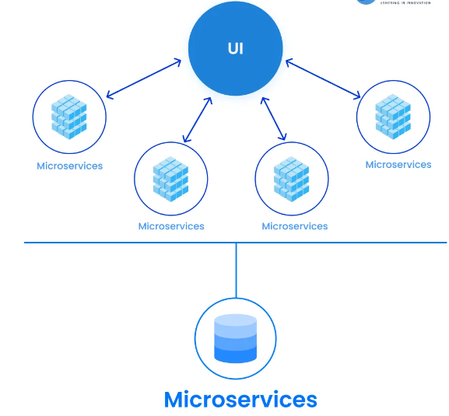

Why to Use Microservice Architecture?
Code base is better understandable
Highly maintainable and testable - enables rapid and frequent development and deployment
Loosely coupled with other services so independently deployable
Improved fault isolation
Adapting new technologies is easier

Slide 9
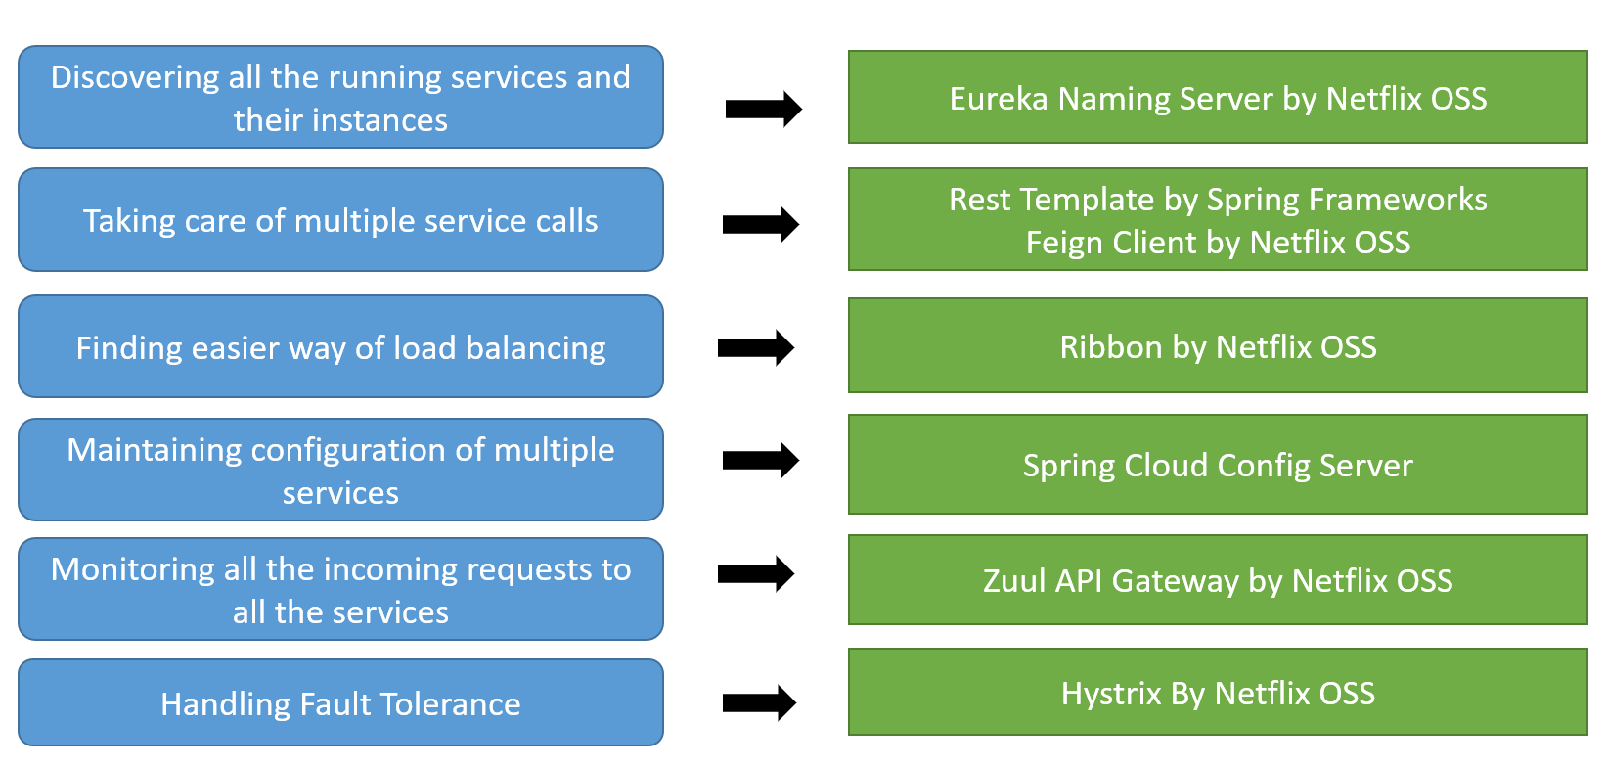
Challenges in Microservices Implementation and How to Resolve It

Slide 10
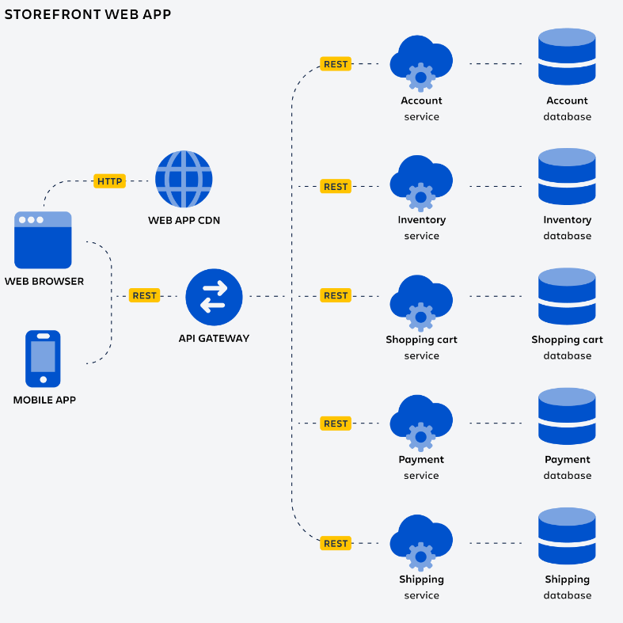
Architecture

Slide 12
Api Gateway

Slide 13
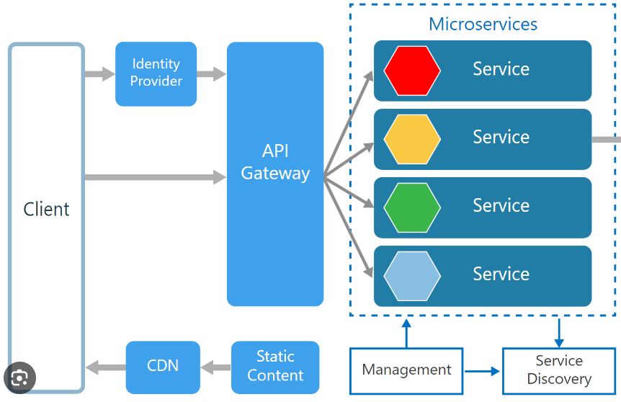
What is Service Discovery?
Service discovery helps you discover, track, and monitor the health of services within a network. Service discovery registers and maintains a record of all your services in a service catalog.
This service catalog acts as a single source of truth that allows your services to query and communicate with each other.

Slide 14
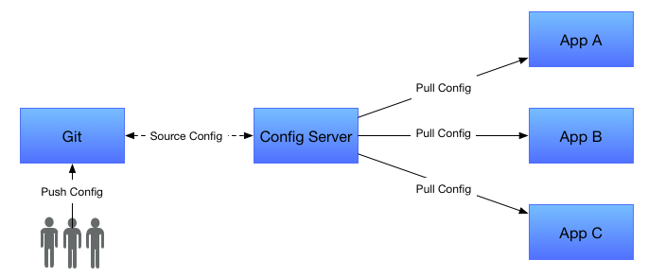
Centralized Configuration Using Spring Cloud Config Server

Slide 15

Microservice Monitoring
Zipkin
Actuator
Prometheus
Grafana
Nagios
Dynatrace

Slide 16

Questions ?

Slide 17

Bibliographie
https://docs.spring.io/spring-cloud-gateway/reference/spring-cloud-gateway/configuring-route-predicate-factories-and-filter-factories.html
https://resilience4j.readme.io/docs/examples-5
https://www.youtube.com/watch?v=QrPvGdpcjXo&list=PL0zysOflRCelb2Y4WOVckFC6B050BzV0D&ab_channel=LearnCodeWithDurgesh
https://www.youtube.com/watch?v=Nb2PPuqtL2g&ab_channel=LearnCodeWithDurgesh
https://www.youtube.com/watch?v=b6R4dElDtRc&ab_channel=JavaTechie
https://www.youtube.com/watch?v=9AXAUlp3DBw
https://www.slideteam.net/search/go?ts=custom&w=MICROSERVICE
https://www.baeldung.com/resilience4j
https://www.baeldung.com/spring-boot-resilience4j
https://www.linkedin.com/company/amigoscode/posts/?feedView=all
https://openclassrooms.com/en/courses/4668216-optimisez-votre-architecture-microservices/exercises/4390

